Slide 1
Module 3: Parallel Databases and Distributed Databases PARALLEL & DISTRIBUTED QUERY PROCESSING

Slide 2
Parallel Query Processing
Different queries/transactions can be run in parallel with each other.
Interquery parallelism
Concurrency control takes care of conflicts in case of updates
Individual relational operations (e.g., sort, join, aggregation) can be executed in parallel
data can be partitioned and each processor can work independently on its own partition.
Queries are expressed in high level language (SQL, translated to relational algebra)
makes parallelization easier.

Slide 3
Intraquery Parallelism
Intraquery parallelism: execution of a single query in parallel on multiple processors/disks; important for speeding up long-running queries.
Two complementary forms of intraquery parallelism:
Intraoperation Parallelism – parallelize the execution of each individual operation in the query
Supports high degree of parallelism
Interoperation Parallelism – execute the different operations in a query expression in parallel.
Limited degree of parallelism

Slide 4
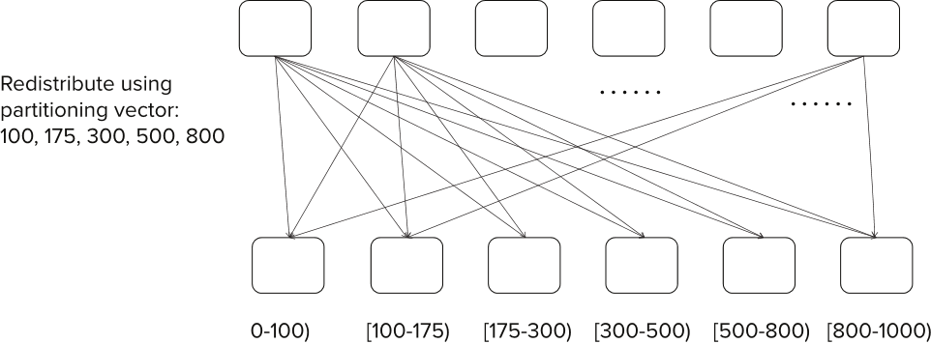
Range Partitioning

Slide 5
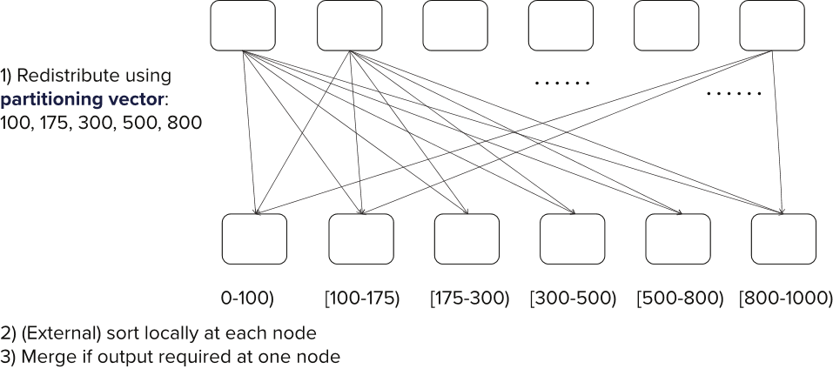
Range-Partitioning Parallel Sort

Slide 6
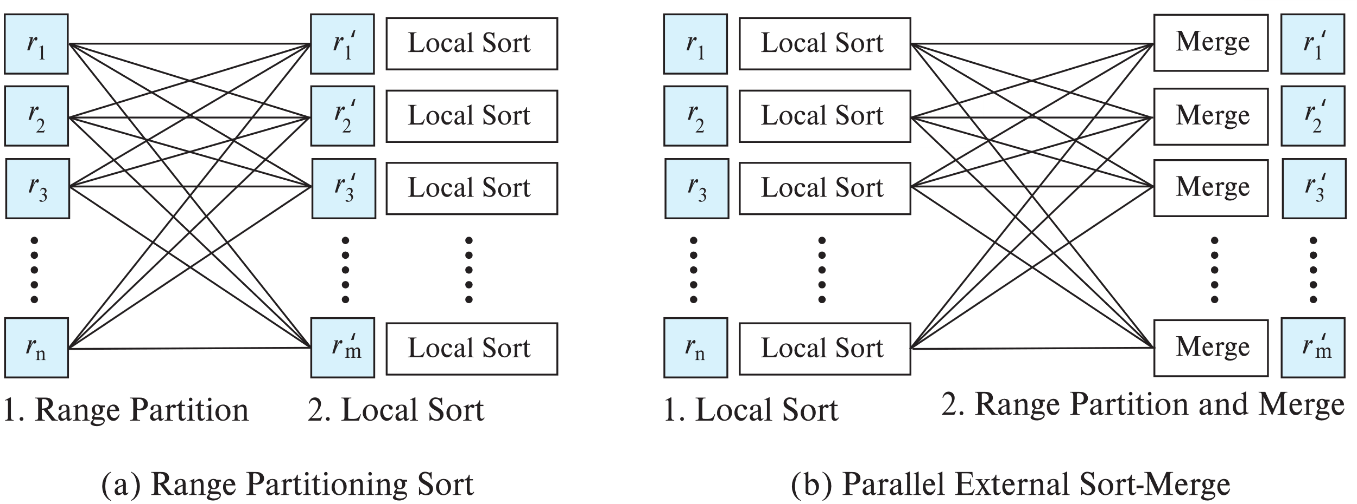
Parallel Sort

Slide 7
Parallel Sort
Range-Partitioning Sort
Choose nodes N₁, ..., N_{m}, where m ≤ n -1 to do sorting.
Create range-partition vector with m-1 entries, on the sorting attributes
Redistribute the relation using range partitioning
Each node N_{i} sorts its partition of the relation locally.
Example of data parallelism: each node executes same operation in parallel with other nodes, without any interaction with the others.
Final merge operation is trivial: range-partitioning ensures that, if i < j, all key values in node N_{i} are all less than all key values in N_{j}.

Slide 8
Parallel Sort (Cont.)
Parallel External Sort-Merge
Assume the relation has already been partitioned among nodes N₁, ..., N_{n} (in whatever manner).
Each node N_{i} locally sorts the data (using local disk as required)
The sorted runs on each node are then merged in parallel:
The sorted partitions at each node Ni are range-partitioned across the processors N₁, ..., N_{n}.
Each node Ni performs a merge on the streams as they are received, to get a single sorted run.
The sorted runs on nodes N₁, ..., N_{n} are concatenated to get the final result.
Algorithm as described vulnerable to execution skew
all nodes send to node 1, then all nodes send data to node 2, …
Can be modified so each node sends data to all other nodes in parallel (block at a time)

Slide 9
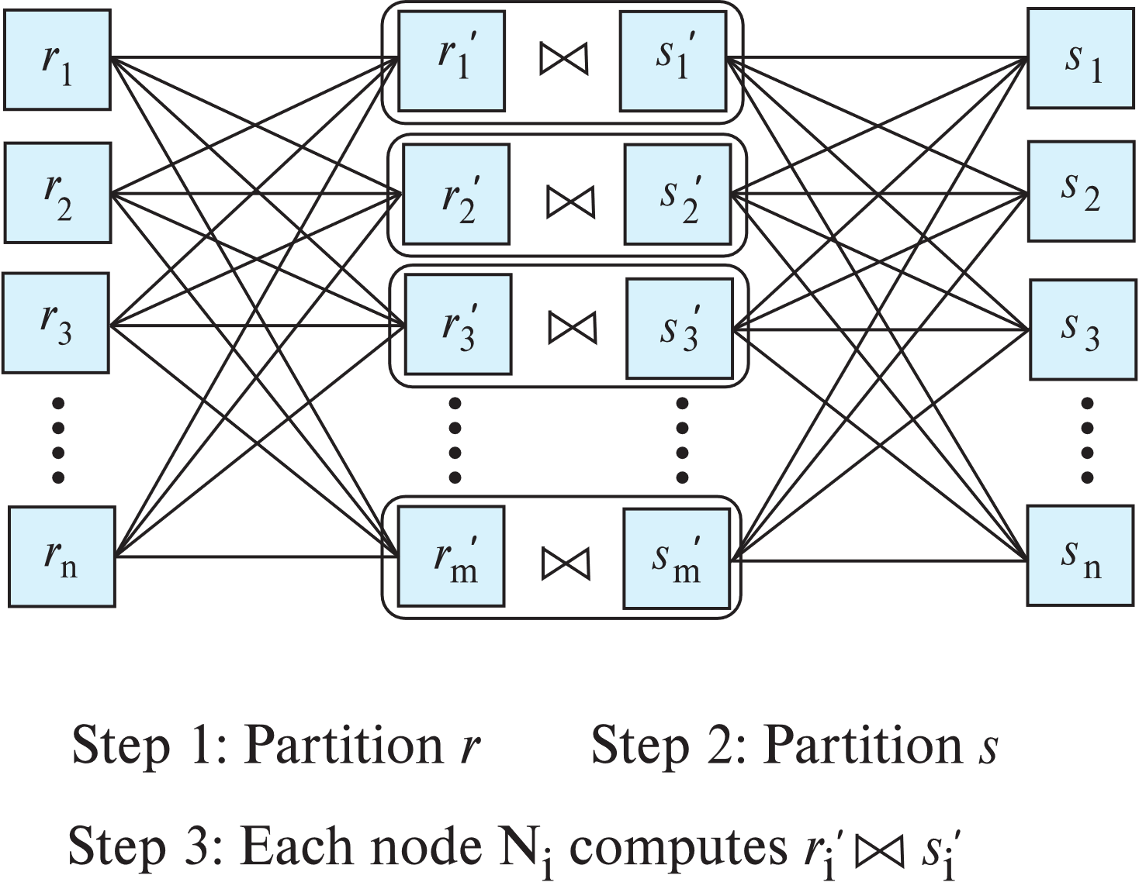
Partitioned Parallel Join
Partition using range or hash partitioning, on join attributes
Notes:
s_k instead of s_n? Move ahead in chapter 23….

Slide 10
Partitioned Parallel Join (Cont.)
For equi-joins and natural joins, it is possible to partition the two input relations across the processors, and compute the join locally at each processor.
Can use either range partitioning or hash partitioning.
r and s must be partitioned on their join attributes r.A and s.B), using the same range-partitioning vector or hash function.
Join can be computed at each site using any of
Hash join, leading to partitioned parallel hash join
Merge join, leading to partitioned parallel merge join
Nested loops join, leading to partitioned parallel nested-loops join or partitioned parallel index nested-loops join

Slide 11
Partitioned Parallel Hash-Join
Parallelizing partitioned hash join:
A hash function h₁ takes the join attribute value of each tuple in s and maps this tuple to one of the n nodes.
As tuples of relation s are received at the destination nodes, they are partitioned further using another hash function, h₂, which is used to compute the hash-join locally.
Repeat above for each tuple in r.
Each node N_{i} executes the build and probe phases of the hash-join algorithm on the local partitions r_{i} and s_{i} of r and s to produce a partition of the final result of the hash-join.
Note: Hash-join optimizations can be applied to the parallel case
e.g., the hybrid hash-join algorithm can be used to cache some of the incoming tuples in memory and avoid the cost of writing them and reading them back in.

Slide 12
DISTRIBUTED QUERY PROCESSING

Slide 13
Data Integration From Multiple Sources
Many database applications require data from multiple databases
A federated database system is a software layer on top of existing database systems, which is designed to manipulate information in heterogeneous databases
Creates an illusion of logical database integration without any physical database integration
Each database has its local schema
Global schema integrates all the local schema
Schema integration
Queries can be issued against global schema, and translated to queries on local schemas
Databases that support common schema and queries, but not updates, are referred to as mediator systems

Slide 14
Data Integration From Multiple Sources
Data virtualization
Allows data access from multiple databases, but without a common schema
External data approach: allows database to treat external data as a database relation (foreign tables)
Many databases today allow a local table to be defined as a view on external data
SQL Management of External Data (SQL MED) standard
Wrapper for a data source is a view that translates data from local to a global schema
Wrappers must also translate updates on global schema to updates on local schema

Slide 15
Data Warehouses and Data Lakes
Data warehouse is an alternative to data integration
Migrates data to a common schema, avoiding run-time overhead
Cost of translating schema/data to a common warehouse schema can be significant
Data lake: architecture where data is stored in multiple data storage systems, in different storage formats, but which can be queried from a single system.

Slide 16
Schema and Data Integration
Schema integration: creating a unified conceptual schema
Requires creation of global schema, integrating a number of local schema
Global-as-view approach
At each site, create a view of local data, mapping it to the global schema
Union of local views is the global view
Good for queries, but not for updates
E.g., which local database should an insert go to?
Local-as-view approach
Create a view defining contents of local data as a view of global data
Site stores local data as before, the view is for update processing
Updates on global schema are mapped to updates to the local views

Slide 17
Unified View of Data
Agreement on a common data model
Typically the relational model
Agreement on a common conceptual schema
Different names for same relation/attribute
Same relation/attribute name means different things
Agreement on a single representation of shared data
E.g., data types, precision,
Character sets
ASCII vs EBCDIC
Sort order variations
Agreement on units of measure

Slide 18
Unified View of Data (Cont.)
Variations in names
E.g., Köln vs Cologne, Mumbai vs Bombay
One approach: globally unique naming system
E.g., GeoNames database (www.geonames.org)
Another approach: specification of name equivalences
E.g., used in the Linked Data project supporting integration of a large number of databases storing data in RDF data

Slide 19
Query Processing Across Data Sources
Several issues in query processing across multiple sources
Limited query capabilities
Some data sources allow only restricted forms of selections
E.g., web forms, flat file data sources
Queries have to be broken up and processed partly at the source and partly at a different site
Removal of duplicate information when sites have overlapping information
Decide which sites to execute query
Global query optimization

Slide 20
Join Locations and Join Ordering
Consider the following relational algebra expression in which the three relations are neither replicated nor fragmented
r1 ⨝ r2 ⨝ r3
r1 is stored at site S₁
r2 at S₂
r3 at S₃
For a query issued at site S_{I}, the system needs to produce the result at site S_{I}

Slide 21
Possible Query Processing Strategies
Ship copies of all three relations to site S_{I} and choose a strategy for processing the entire locally at site S_{I.}
Ship a copy of the r1 relation to site S₂ and compute temp₁ = r1 ⨝ r2 at S₂.
Ship temp₁ from S₂ to S₃, and compute temp₂ = temp₁ ⨝ r3 at S₃
Ship the result temp₂ to S_{I}.
Devise similar strategies, exchanging the roles S₁, S₂, S₃
Must consider following factors:
amount of data being shipped
cost of transmitting a data block between sites
relative processing speed at each site

Slide 22
Semijoin Strategy
Let r₁ be a relation with schema R₁ stores at site S₁
Let r₂ be a relation with schema R₂ stores at site S₂
Evaluate the expression r₁ ⨝ r₂ and obtain the result at S₁.
Compute temp₁ ← ∏_{R1 ∩ R2} (r1) at S1.
Ship temp₁ from S₁ to S₂.
Compute temp₂ ← r₂ ⨝ temp1 at S₂
Ship temp₂ from S₂ to S₁.
Compute r₁ ⨝ temp₂ at S₁. This is the same as r₁ ⨝ r₂.

Slide 23
Semijoin Reduction
The semijoin of r₁ with r₂, is denoted by:
r₁ ⋉ r₂ ∏_{R1} (r₁ ⨝ r₂)
Thus, r₁ ⋉ r₂ selects those tuples of r₁ that contributed to r₁ ⨝ r₂.
In step 3 above, temp₂=r₂ ⋉ r₁.
For joins of several relations, the above strategy can be extended to a series of semijoin steps.
Semijoin can be computed approximately by using a Bloom filter
For each tuple of r₂ compute hash value on join attribute; if hash value is i, and set bit i of the bitmap
Send bitmap to site containing r₁
Fetch only tuples of r₁ whose join attribute value hashes to a bit that is set to 1 in the bitmap
Bloom filter is an optimized bitmap filter structure (Section 24.1)

Slide 24
Distributed Query Optimization
New physical property for each relation: location of data
Operators also need to be annotated with the site where they are executed
Operators typically operate only on local data
Remote data is typically fetched locally before operator is executed
Optimizer needs to find best plan taking data location and operator execution location into account.

Slide 25
Distributed Directory Systems
Distributed directory systems are widely used
Internet Domain Name Service (DNS)
Lightweight Directory Access Protocol (LDAP)
Widely used to store organizational data, especially user profiles
Data in a distributed directory system are stored and controlled in a distributed hierarchical manner
E.g., data about yale.edu is provided by a Yale, and about IIT Bombay by an IIT Bombay server
Data can be queries in a uniform manner regardless of where it is stored
Queries get forwarded to the site where the information is stored

